Slide 1
University of BasraH Al-zahraa medical college
Ministry of higher Education and Scientific Research
REPRODUREVTIVE SYSTEM MODULE
SESSION 3
LECTURE:1
DURATION:1 hr
puberty and menopause
Module staff
Dr. Raya Muslim Alhassan (module leader)
Dr. Nehaya Mnahi Al-Aubody
Dr. Nada Hashim Al-jassim
Dr. Nawal Mustafa Abdulah
Dr . Alaa hufdhi
Dr .Hadeel S. AlAli
Gynaecology by ten teachers,20th Edition, edited by Helen Bickerstaff and Louise C Kenny,2017 ,by Taylor & Francis Group.

Slide 2
Learning Objectives (LO)
University of Basrah Al-zahraa medical college
Ministry of higher Education and Scientific Research
1-Describe the sequence of physiological and anatomical changes that occur in the male and female at puberty 2-Describe the mechanism underlying such changes at puberty 3-Describe the hormonal changes which lead to the features of the menopause 4-List the advantages and disadvantages of hormone replacement therapy in the post- menopausal woman
-Describe common menstrual problems and how in principle they may assessed and managed

Slide 3
. (LO 1) The sequence of physiological and anatomical changes that occur in the male and female at puberty
Primary sexual characteristics are established before birth, but the reproductive system is inactive until puberty. The age at which puberty takes place varies, but girls begin and end puberty before boys.
3

Slide 4
(LO 1)
Changes in the Male at Puberty (Begins 9-14 Years)
Genital development
Adrenarche
Spermatogenesis
Growth spurt
Adult shape of genitelia and pubic hair

Slide 5
(LO 1)
Changes in the Female at Puberty (Begins 8-13 Years)
Thelarche
Adrenarche
Growth spurt
Menarche
Adult shape
5

Slide 6
(LO 2)
the mechanism underlying such changes at puberty
*-Puberty is under hormonal control; the start of puberty is associated with a steady rise in FSH and LH secretion. The brain initiates puberty. *-Pulsatile GnRH secretion leads to rise in FSH and LH

Slide 7
Body weight is the most important factor in the timing of puberty Critical weight is 47kg for menarche * If body weight falls significantly below this the reproductive cycle ceases (may be signalled to the brain by Leptins) Growth spurt start weight is 30kg for girls and 55kg for boys
(LO 2)
Body Weight

Slide 8
Adrenarche (Pubic and Axillary hair) Depends on androgens in both sexes * From adrenal glands in girls Growth Spurt Occurs in both sexes, but is earlier and shorter in girls Men are larger as growth spurt is longer and slightly faster It Depends on Growth Hormone and Steroids in both sexes and Ended in both sexes by epiphyseal fusion *Oestrogen closes epiphyses earlier in girls. Oestrogen is needed to initiate the growth spurt, but once levels reach a certain point it causes the epiphyses to fuse.
Thelarche (Breast Development) Dependant on oestrogen Male Genital Development Dependant on testosterone
8

Slide 9
Tanner’s staging
(LO 2)
Pubertal development was described by Tanner and depends on the stages of breast, genitals and pubic hair development ,it ranges from 1 to 5.

Slide 10
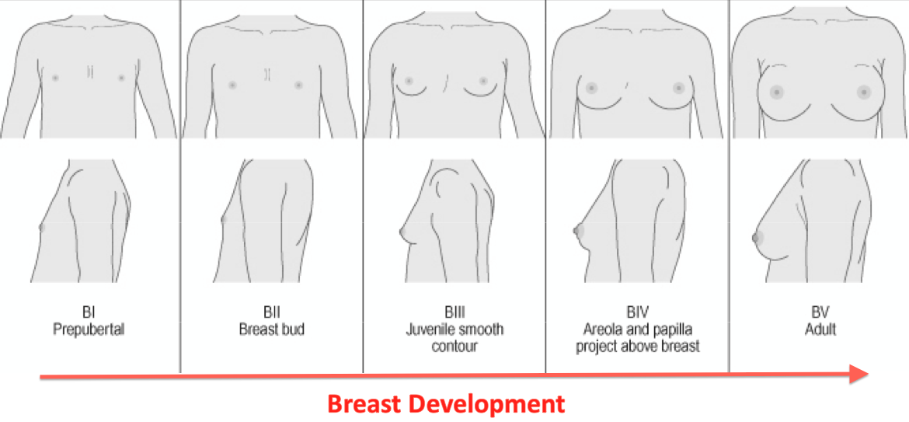
10

Slide 11
11

Slide 12
Precocious Puberty
(LO 2)
Most parts of the reproductive system can work before the normal age of puberty, but they didnt do so because hormone levels are too low. This is a result of low GnRH secretion. Precocious Puberty mean The development of the signs of puberty before the age of 8 in Girls or 9 in Boys .
True (centeral): due to neurological causes. Early stimulation of central maturation giving early, inappropriate GnRH secretion. The cause of the majority is unknown, but they can be due to nurological causes: like * Pineal tumours *Meningitis psudo (peripheral): uncontrolled Gonadotrophin or steroid secretion like * Hormone secreting tumours

Slide 13
Dignosis
(LO 2)
Hormonal assay
1.history &examination
US
MRI
GnRH stimulation test

Slide 14
Treatment
(LO 2)
Explaination & reassurance in idiopathic causes
Stop the causative drug
removal of tumour
GnRH agonist

Slide 15
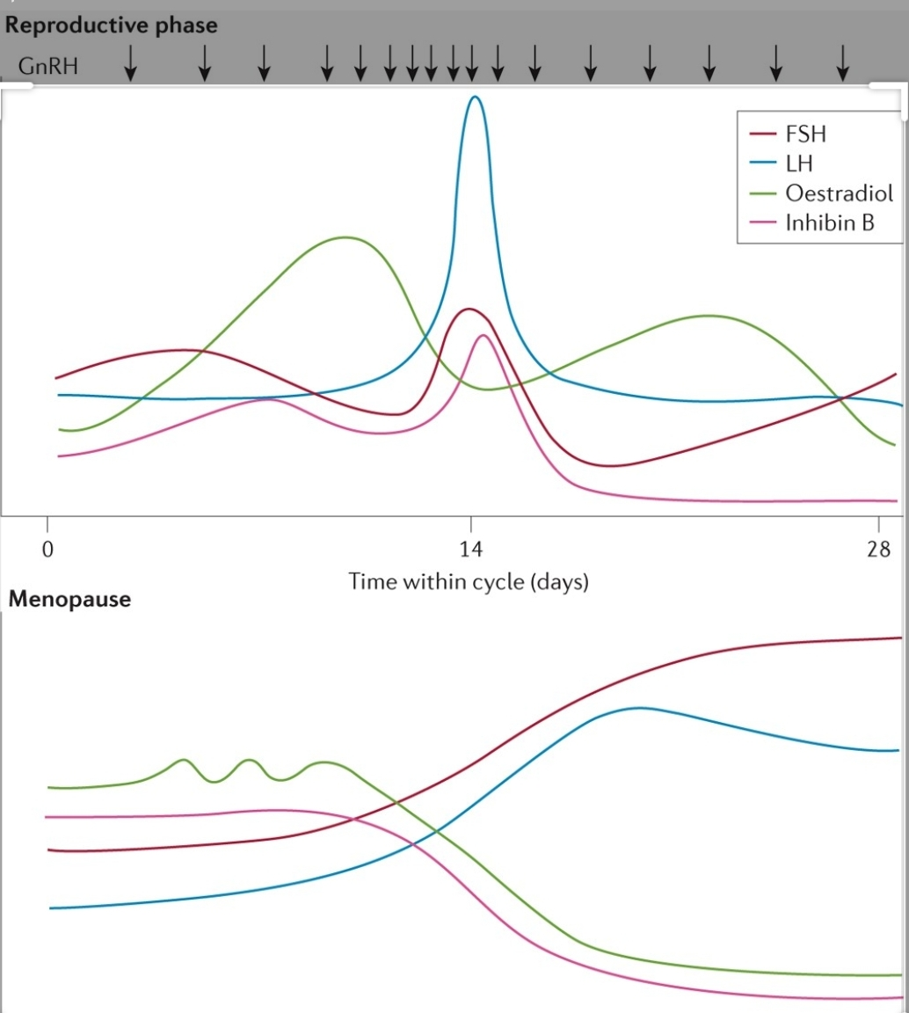
End of Reproductive Life – Females The Climacteric / Menopause
(LO 3)
Hormonal Changes that lead to the features of the menopause

Slide 16
(LO 3)
Pre-Menopause
> 40 years Changes in the menstrual cycle * Follicular phase shortens, with ovulation early or absent * Less oestrogen secreted - Less –‘ve feedback, so LH and FSH levels rise - FSH rises more due to loss of Inhibin too Reduced fertility, though still possible to get pregnant

Slide 17
The Menopause Cessation of menstrual cycles Average age 51, but varies Female has run out of follicles Oestrogen levels fall dramatically * Less –‘ve feedback, so LH and FSH levels rise * FSH rises dramatically due to loss of Inhibin too
(LO 3)
18

Slide 18
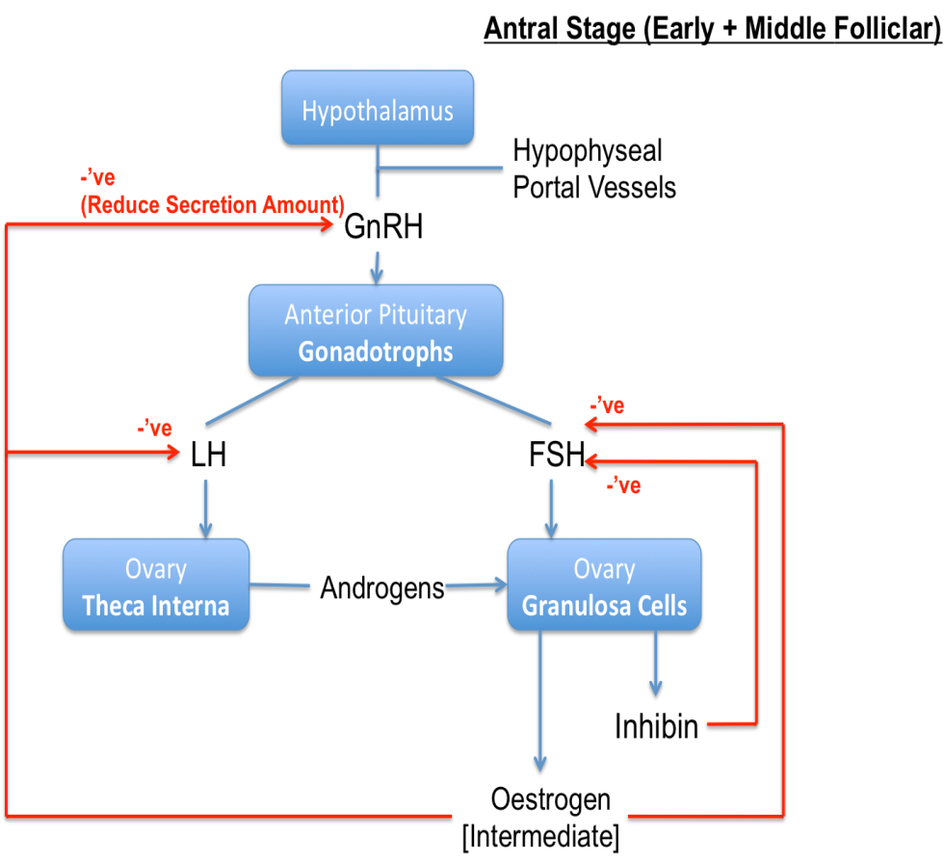
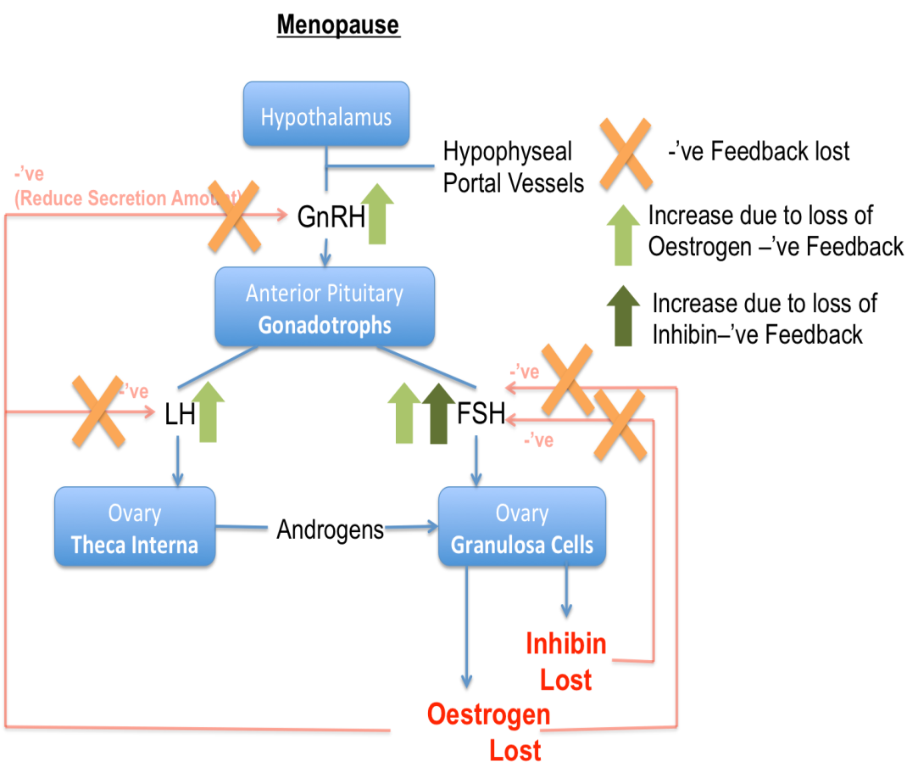
(LO 3)

Slide 19
(LO 3) Effects of Menopause
Vascular
Genital
Bone
( I ) Vascular Hot flushes affect ~80% to some degree Transient rises in skin temperature and flushes Relieved by Oestrogen treatment *So must be due to decrease in oestrogen

Slide 20
(LO 3)
(II ) Oestrogen Sensitive Tissues Uterus Regression of endometrium Shrinkage of myometrium Shrinks away into a very small organ cervix thinning of cervix Vagina rugae lost Thinner, less distensible Breast Involution of some breast tissue Changes in skin Bladder Reduction in bladder tone

Slide 21
(LO 3)
( III )Bone Bone mass reduces by 2.5% per year for several years Increased resorption relative to production leading to Osteoporosis * Much greater in some than others * Major reason for fractures in later life * Can be limited by Oestrogen therapy

Slide 22
Hormone Replacement Therapy HRT
(LO 4)
Advantiges
_Relieves symptoms of the menopause _Easy administration Orally or topically by patch or gel _Can limit osteoporosis, but no longer recommended for first line protection (Biphosphonates now recommended) _Not advised for cardio-protection .

Slide 23
Disadvantages
HRT increases risk of malignancy due to the effect of estrogen specially endometrial and breast malignancies
It has some risk of DVT

Slide 24
Describe A common menstrual dysfunctions
There are many terms for menstrual dysfunctions all defined in details in the next lecture and the common problems are discussed in brief

Slide 25
THANK YOU

